Slide 1
Adding Sequences to P0
Sujan Kandeepan, Razi Syed, Afzal Chishti
Date: April 2021

Slide 2
Introduction
Adding sequence data type to P0 language and compiler
Support sequence operations:
Express sequences as literals and ranges
Sequence indexing and selecting subsequences
Concatenation of sequences
Memory management due to dynamic size
Similar to data types such as lists in Python

Slide 3
Implementation
Augment existing array type instead of defining new sequence type
Extend language syntax to support new language features
Modify parser to accept new syntax and update grammar
Additional error handling with new syntax rules
Array literals and subarrays as references to original array
Avoid duplicating array contents into new memory locations
New types/constructors easier code readability
Overload existing operators adding support for arrays
Eg. ‘:=’ for populating entire arrays, ‘+’ for concatenation

Slide 4
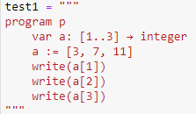
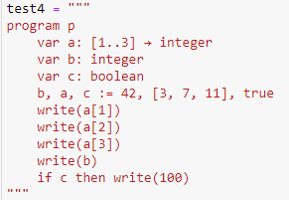
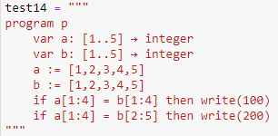
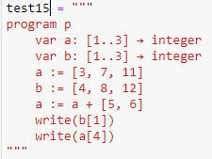
Testing the implementation - Validation
10 test cases of simple array literal assignment for integers
1 test case of simple array literal assignment for boolean
1 test case for testing indexing
2 test cases for multiple assignment
3 test cases for comparing arrays
3 test cases for testing subarrays
5 test cases for array concatenation

Slide 5
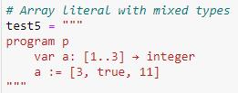
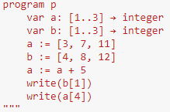


Testing the implementation - Error checking
2 test cases for ensuring array literal fails when storing mixed types
12 test cases for testing out of bounds
1 test case for non-increasing ranges
1 test case for non-integer ranges
2 test cases to ensure only concatenation for two arrays of same type works
1 test case for concatenation

Slide 6


Statistics
1252 number of lines
179 - P0
63 - CGwat
2 - CGast
343 - TestLiterals
423 - TestIndex
228 - TestConcat
14 - ST
43 number of tests
25 - Validation
18 - Error checking

Slide 7


Development
Whether to add to array data type or create new
To prevent reduplication of work
Array already provided many features that would be expected of new data type
Memory allocation
Looked into compilers such as Emscripten, Clang
Ton of overhead in these approaches
Wasted memory and shifting memory was out of context for this approach
Utilized memory.copy

Slide 8
Conclusion
Takeaways
Memory management
Insightful to work with
Next steps
Array literals
Allow decreasing range (eg. s:=[5..1])
Subarrays
Allow negative indexing (eg. s[2: -2])
Allow one of the values for indices to be null (eg. s[:7])
Memory allocation
Shift bytes and memory address over

Slide 9
References
Rossberg, A. (n.d.). WebAssembly Specification. Retrieved March 10, 2021, from https://webassembly.github.io/spec/core/
WebAssembly. (n.d.). Retrieved March 10, 2021, from https://developer.mozilla.org/en-US/docs/WebAssembly
Design and History FAQ. (n.d.). Retrieved March 10, 2021, from https://docs.python.org/3/faq/design.html#how-are-lists-implemented-in-cpython
Ahn, H. (2021, March 31). WebAssembly/bulk-memory-operations. Retrieved April 14, 2021, from https://github.com/WebAssembly/bulk-memory-operations/blob/master/proposals/bulk-memory-operations/Overview.md
Conrad Watt, Andreas Rossberg, and Jean Pichon-Pharabod. 2019. Weakening WebAssembly. Proc. ACM Program. Lang. 3, OOPSLA, Article 133 (October 2019), 28 pages. https://doi.org/10.1145/3360559
Building to webassembly. (n.d.). Retrieved April 12, 2021, from https://emscripten.org/docs/compiling/WebAssembly.html

